Slide 1
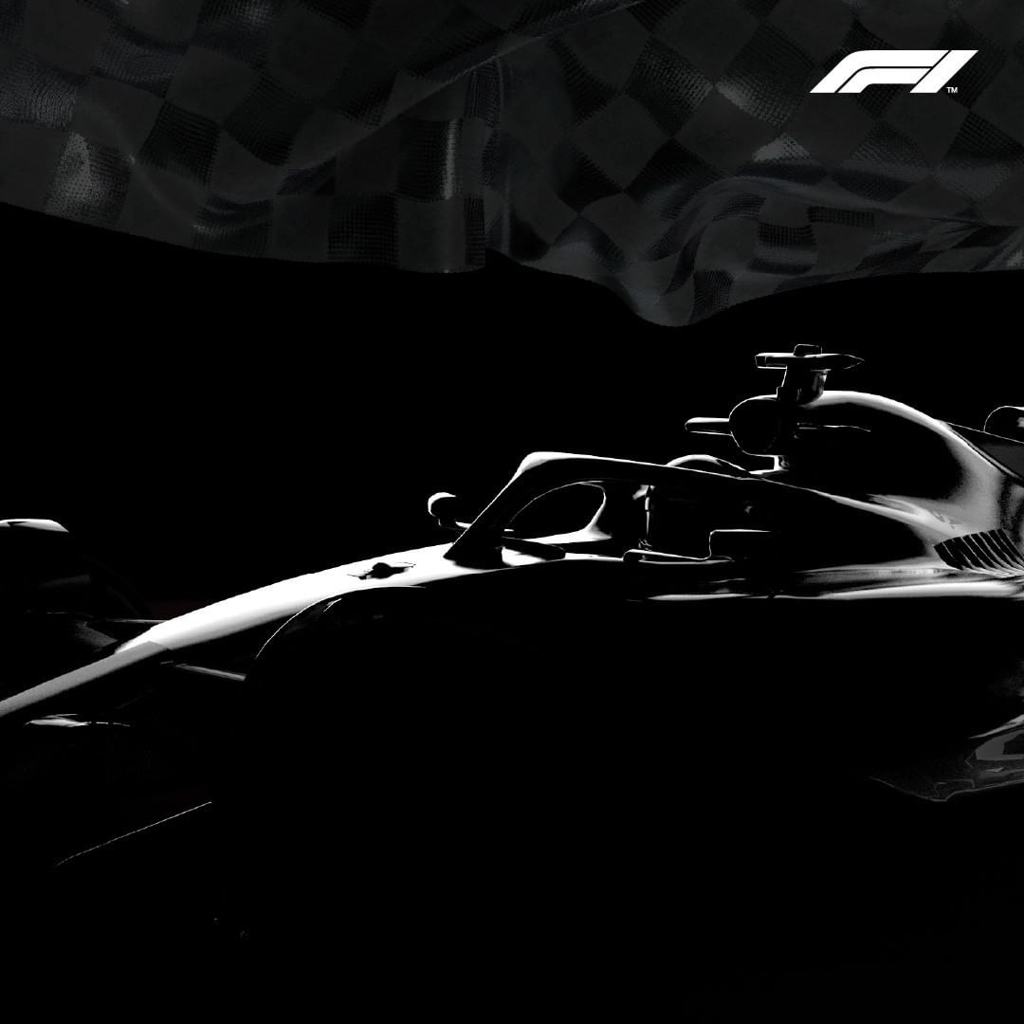
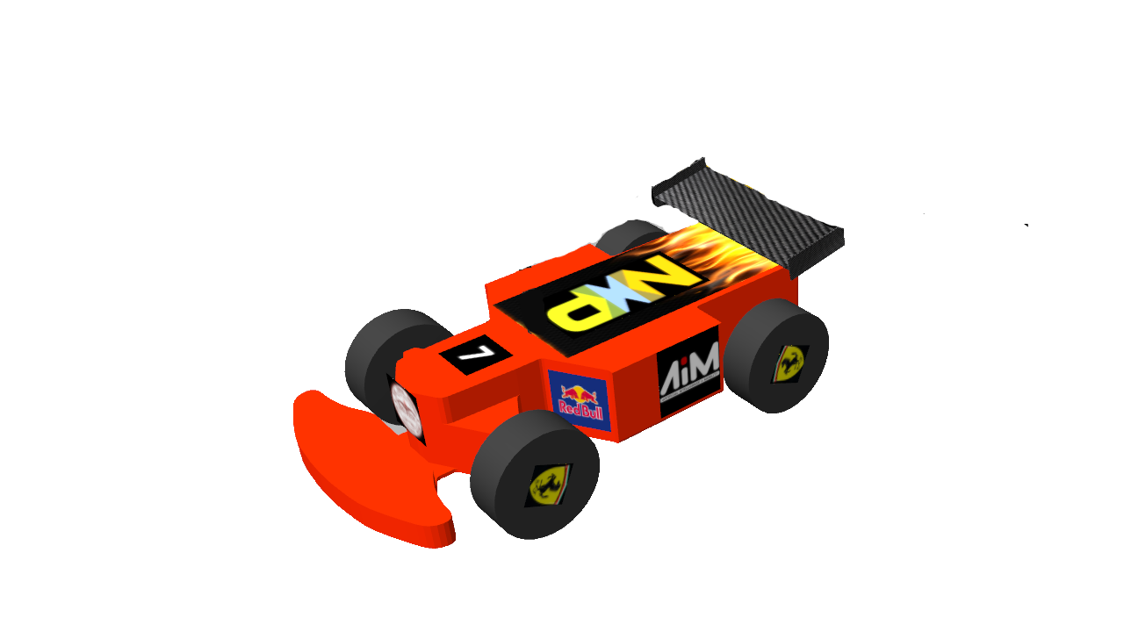

Defianz Racing
Defying all odds
Notes:
1,2,3,4,6,→Shaurya, 5,7,8,9-→ Aniket

Slide 2

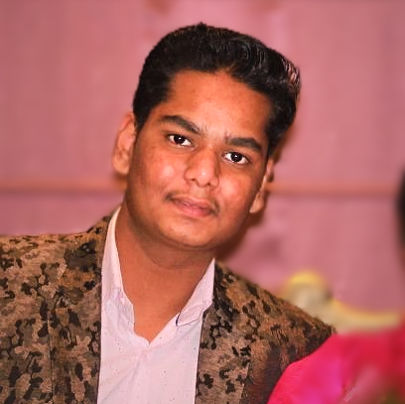

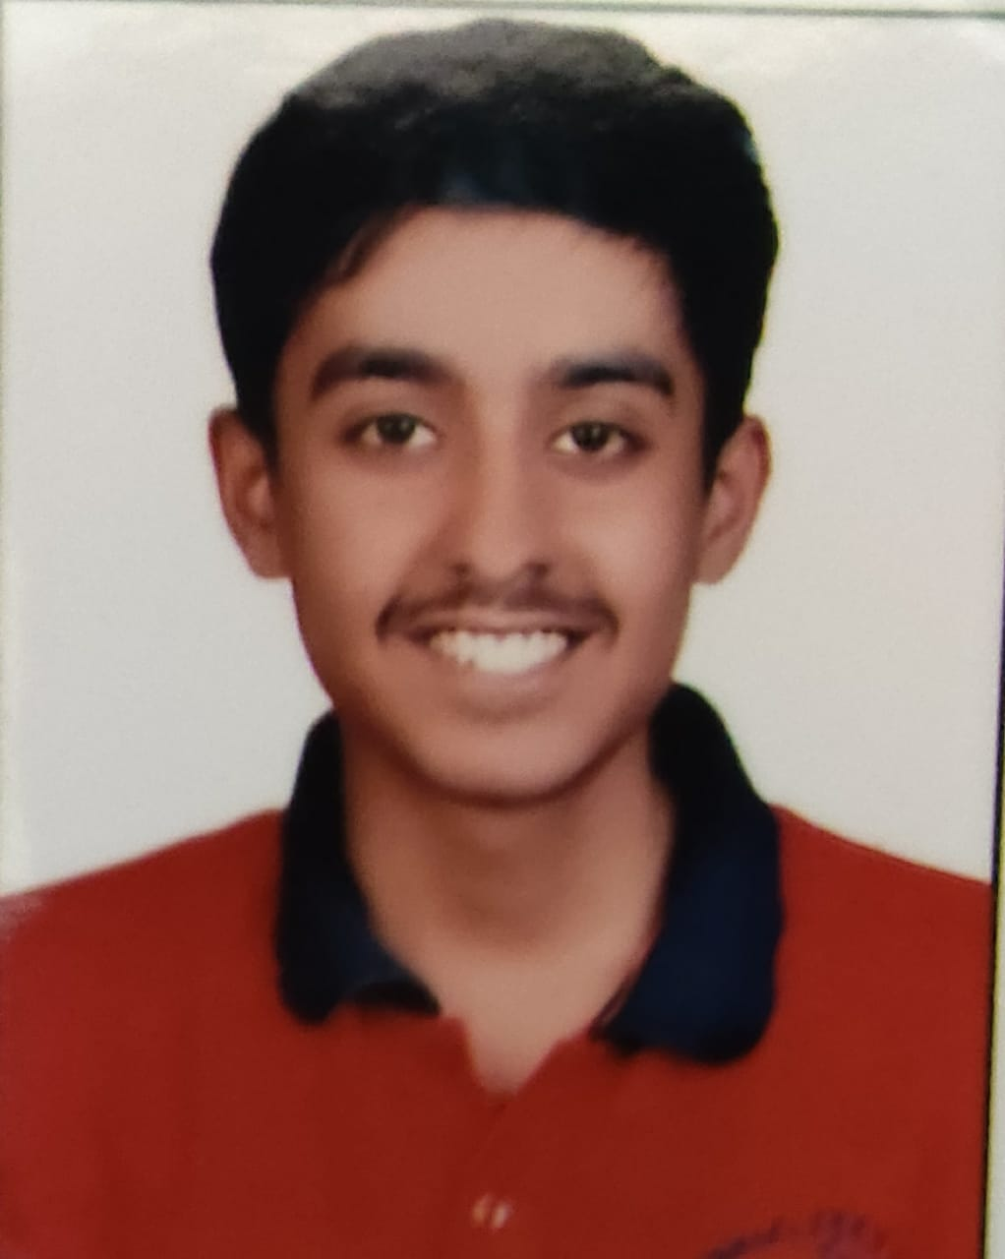
Meet the Team
Defianz
Racing
Delhi Technological
University
Shaurya K. Panwar
Aniket Singh
Tanmay Jain
Controls Lead
Perception Lead
Software Lead
B.Tech (Engineering Physics) – II Sem
B.Tech (Computer Science) – II Sem
B.Tech (Computer Science) – IV Sem
Designed and implemented Convolutional Neural Networks for track Recognition and predicting the Required Steering Angle.
Implemented Object Detection algorithm YOLO for obstacle and Traffic Sign Detection for Safely navigating the track
Combined all the algorithms for optimal performance and tuned Hyperparameters for their best Performance

Slide 3
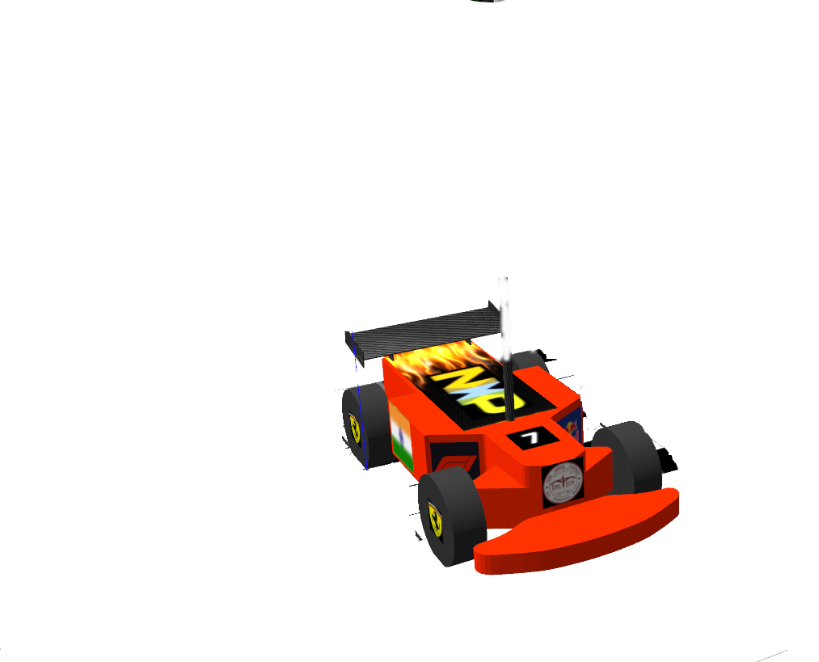
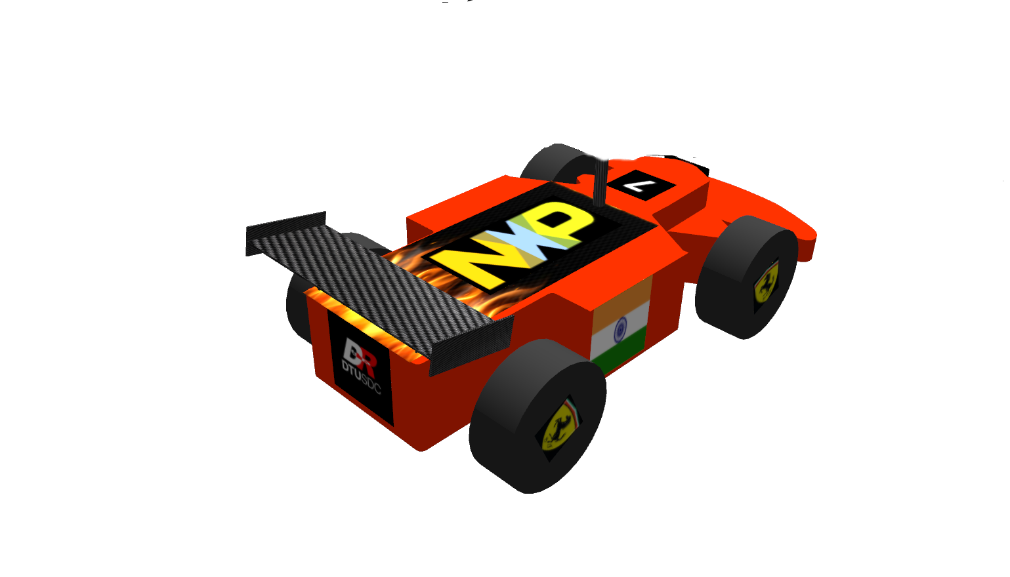
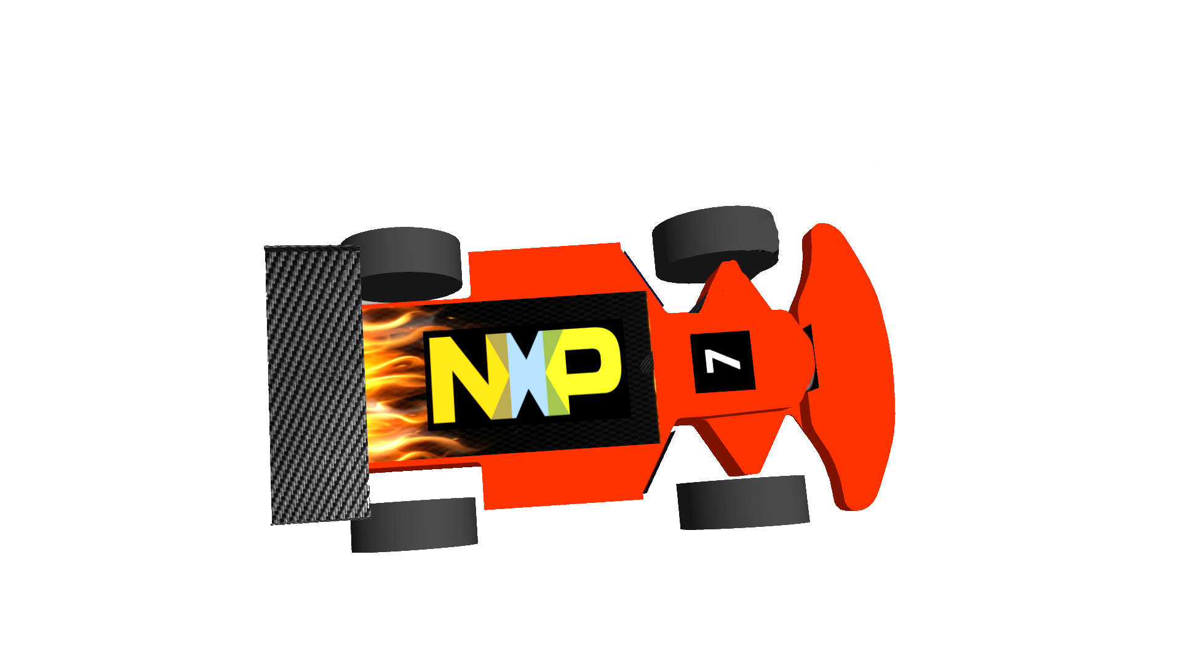
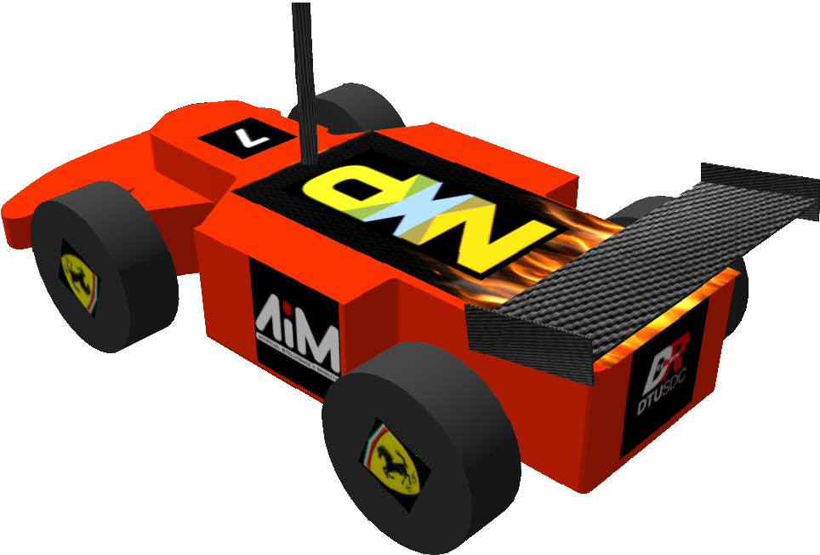
Car Model

Slide 4
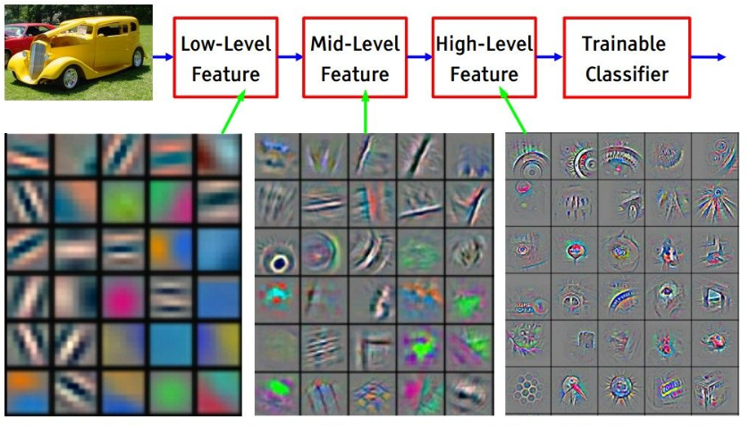
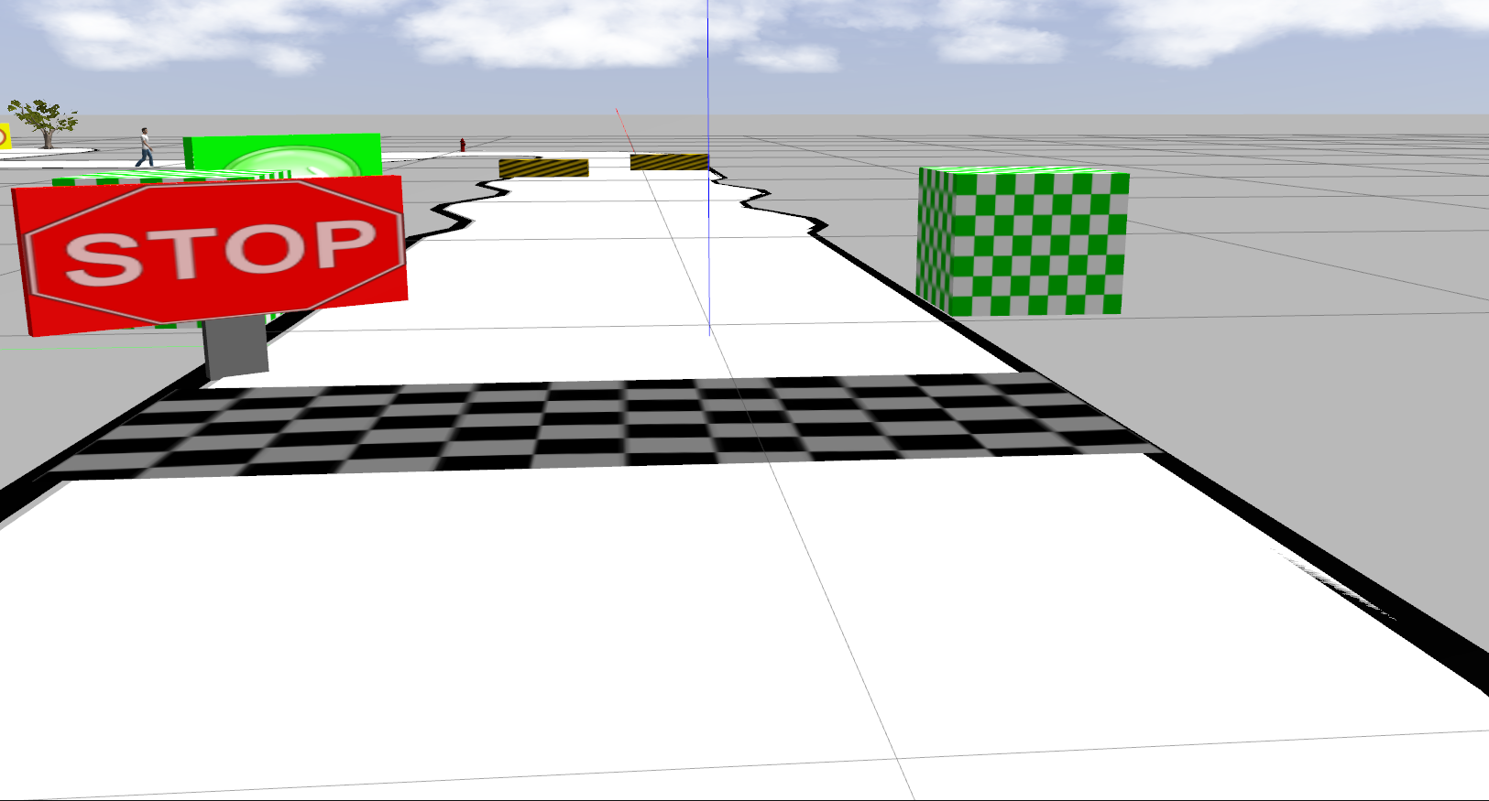
Interface & Sensor Details
Pixy Cam
(Versatile RGB Camera)
Even though we were given a choice to use 2 sensors, but we chose to go with only the Camera, using a humanistic approach to driving.
Main Heart of our system.
Provides us with a Wide FOV color Image
Used as primary input for our CNN(Convolutional Neural Network) for steering Prediction and YOLO(You Only Look Once) for Traffic Sign Recognition.
Provided by NXP, as the basic sensor.
Capable of driving fully Autonomously using only Pixy Cam Input.

Slide 5
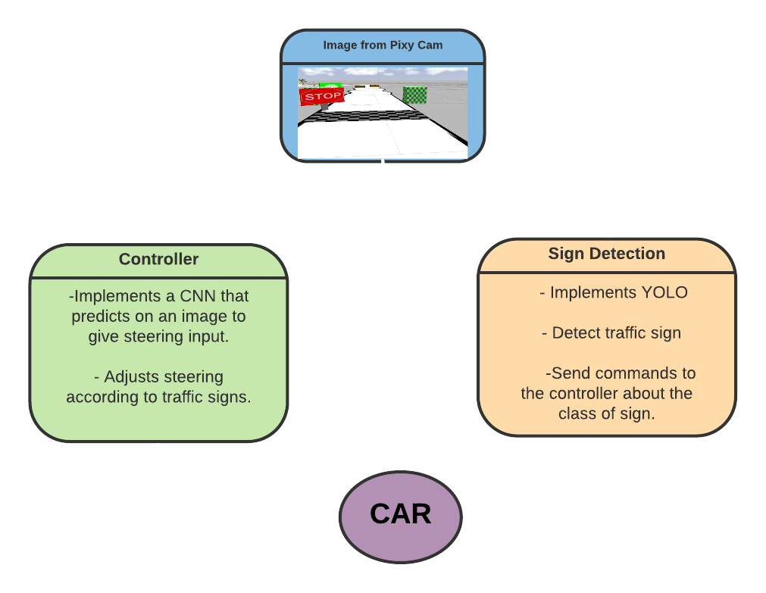
Software Architecture

Slide 6
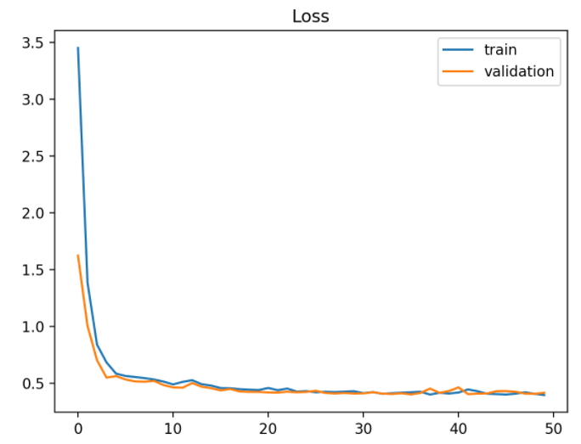
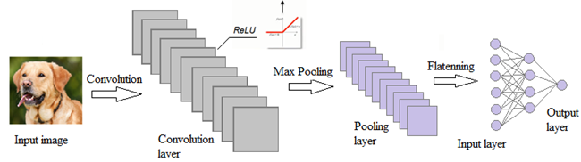
Convolutional Neural Networks (CNN)
CNNs are the backbone for our Control System
Input 216x216x3 Image as Input.
Returns float from -1 to 1 using Tanh activation
Used “Conv-Conv-Pool” Architecture
Used Batch Normalization and Dropout for Regularization.
Loss Vs Epoch Graph

Slide 7
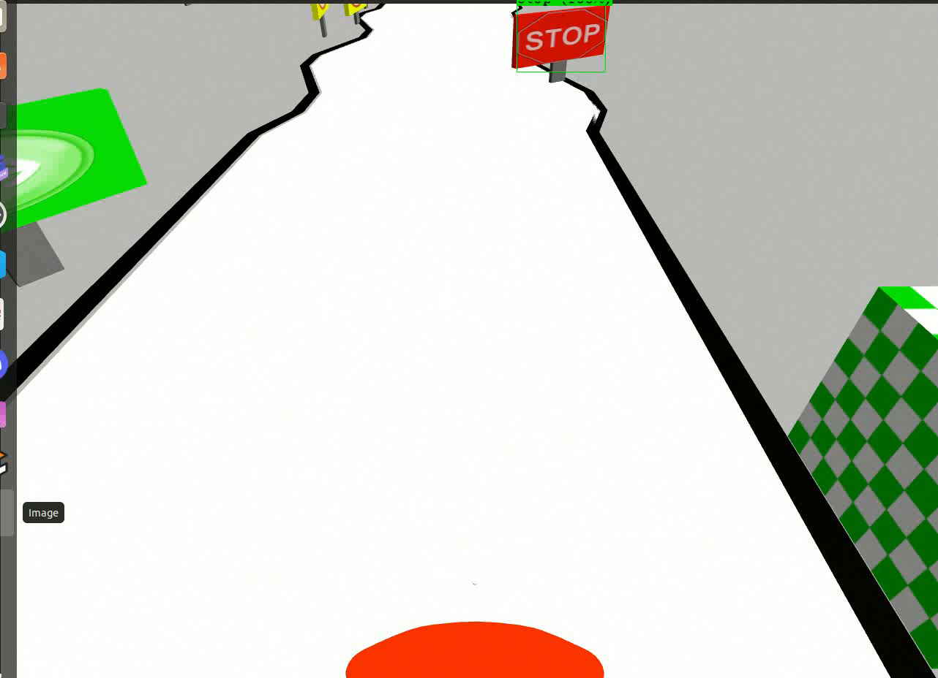
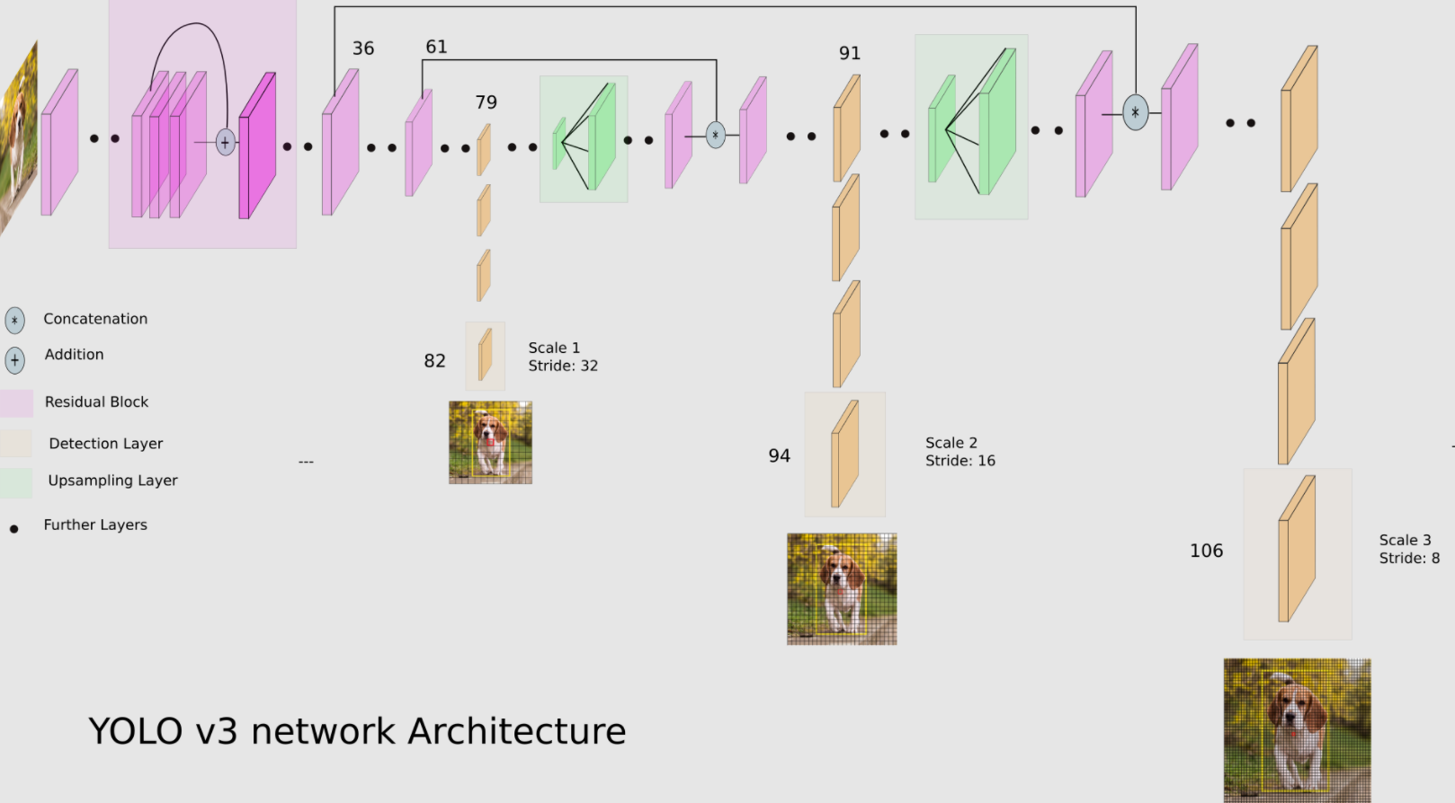
YOLO
YOLO v4 is an object detection deep neural network, machine learning algorithm.
Optimized and trained for traffic sign detection in gazebo simulator by creating our own training dataset.
Final output gave us accurate class predictions with bounding box around the traffic signs
Yolo makes predictions at 3 layers in it’s CNN, Thereby providing accurate predictions from even the smallest or the largest object in the Image.
We chose YOLO V4 Tiny because of its fast inference time and substantially better accuracy compared to RCNNs(Sliding Window Approach).
Notes:
Explain About YOLO

Slide 8
Coding Practices
Modularization
Code is Readable
Comments and Documentation
DRY - Don’t Repeat Yourself
Keep it Simple
Using Descriptive Names
Portable and Buildable
Consistent Indentation
Code Refactoring

Slide 9
Summary
We used Humanistic approach for driving i.e., we mostly relied on the input of the image to detect and avoid obstacles.
We have used ML algorithms that are currently being researched and used as a benchmark technology in Self Driving Car industries.
Our current approach is inspired from Tesla, which mostly relies on its cameras for self driving.
It was a great opportunity for us to learn and excel. We came across wide varieties of challenges and while solving them, we learnt many new things that are going to help us in the future.
We would like to Thank each and every member of NXP Team for their Support
Notes:
For example: YOLO V4 tiny were using was developed 2 months back

Slide 10
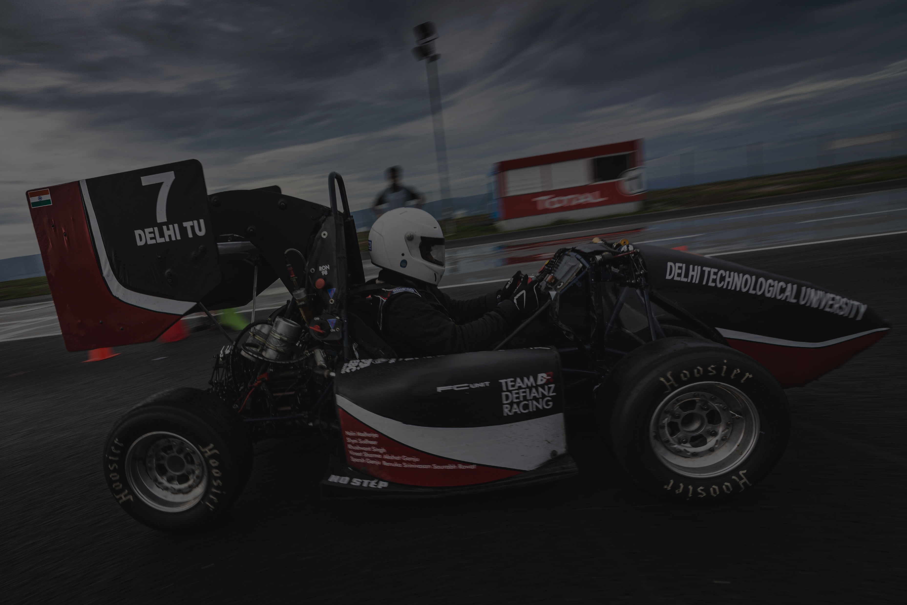
Thank You

